Slide 1

Knowledge Graphs
How to Create a Knowledge Graph from Structured Data?

Slide 2
Outline
Overview
Schema Mapping
Record Linkage
Summary

Slide 3
Overview
Large organizations have lot of internal data
Customer profiles
Product offerings
Transactions
They also consume external data from third party providers
News reports
Funding decisions
Supplier relationships

Slide 4
Overview
Knowledge graph by integrating external and internal data
360 view of customer
Fraud detection
Risk assessment

Slide 5
Overview
Knowledge graph by integrating external and internal data
Schema design
Relating the schema of sources to the knowledge graph schema
Record linkage
Recognizing if two instances refer to the same object in the real-world

Slide 6
Schema Mapping
Practical challenges
Example of schema mapping
Specifying schema mapping
Bootstrapping schema mapping

Slide 7
Practical Challenges
Difficult to understand schema
Large tables, unhelpful names (e.g., segment1, segment2, etc.)
Mappings are not always one-to one
Need to apply business logic
Training data not available
Data for schema mappings is even more scarce

Slide 8
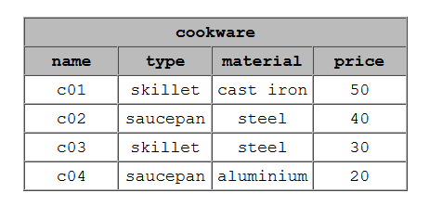
Example Schema Mapping

Slide 9
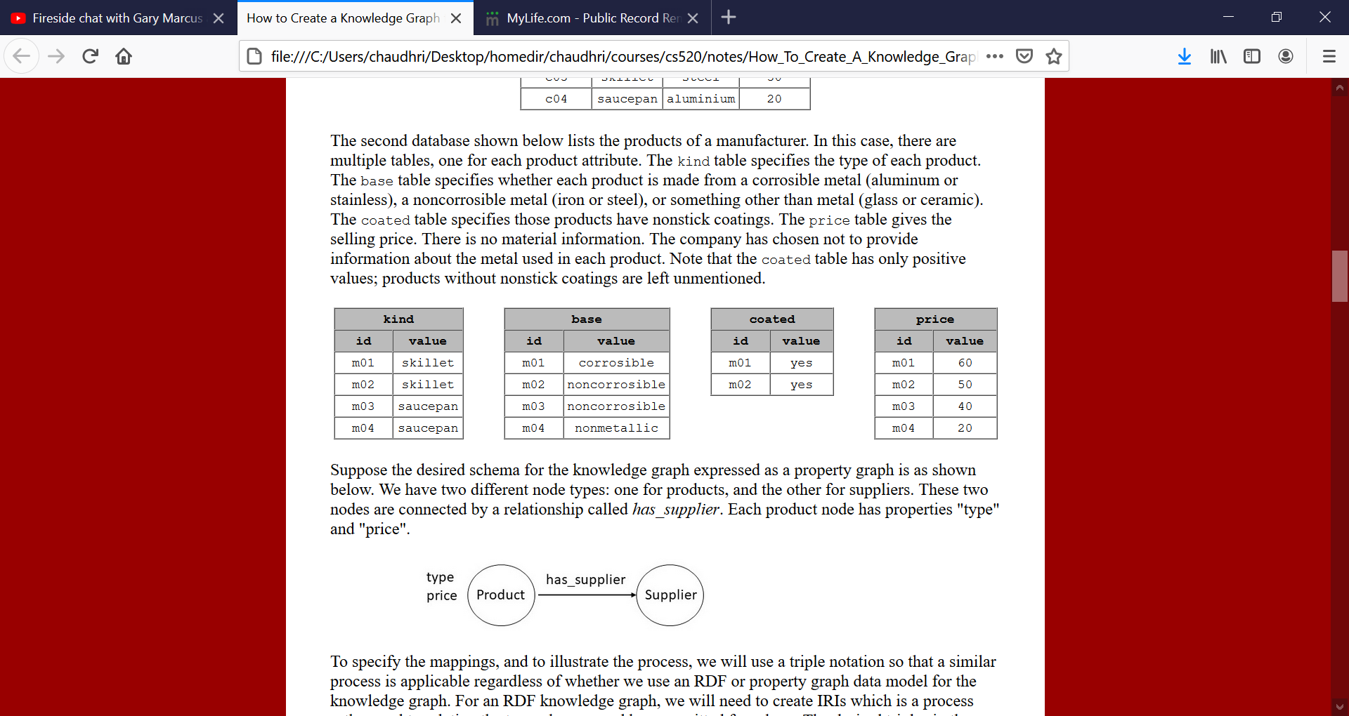
Example Schema Mapping

Slide 10
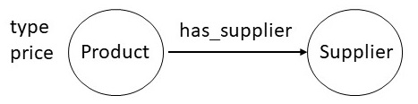
Example Schema Mapping

Slide 11
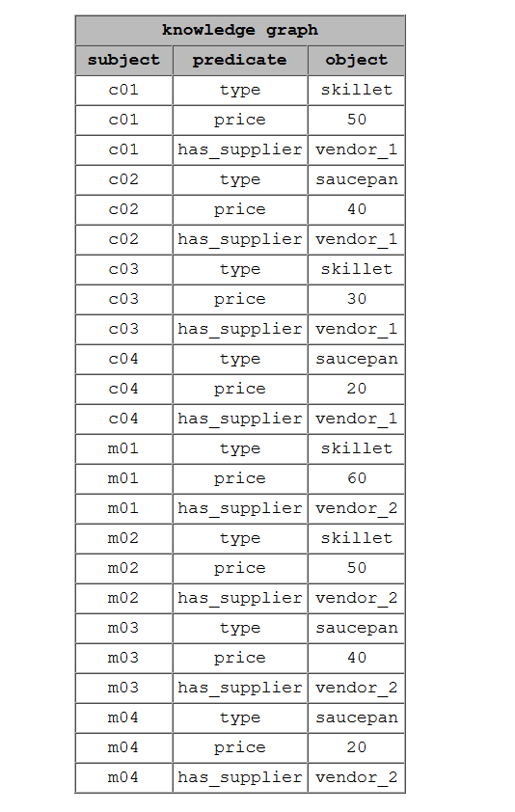

Slide 12
Example Schema Mapping
knowledge_graph(ID,type,Type) :- cookware(ID,TYPE,MATERIAL,PRICE) knowledge_graph(ID,price,PRICE) :- cookware(ID,TYPE,MATERIAL,PRICE) knowledge_graph(ID,has_supplier,vendor_1) :- cookware(ID,TYPE,MATERIAL,PRICE)

Slide 13
Example Schema Mapping
knowledge_graph(ID,type,Type) :- kind(ID,TYPE) knowledge_graph(ID,price,PRICE) :- price(ID,PRICE) knowledge_graph(ID,has_supplier,vendor_2) :- kind(ID,TYPE)

Slide 14
Bootstrapping Schema Mapping
Linguistic Mapping
Mapping based on instances
Mapping based on constraints

Slide 15
Bootstrapping Schema Mapping
Linguistic Techniques
Leverage the name
Best solution is to use IRIs and sameAs links
Stemming, Synonym, Hypernym
Cname and Customer Name
Automobile and Vehicle
Book and Publication
Common substrings/pronunciation
Amount Received/Amount Receivable
Bell vs Belle
Leverage documentation string
Extract keywords, and check semantic similarity

Slide 16
Bootstrapping based on Instances
Examine the data
If we can recognize the data contain phone number, zip code, ISBN, SSN, Date that can provide strong guidance for which attributes can match

Slide 17
Bootstrapping based on Constraints
Leverage the constraints
Value range constraints, uniqueness, optionality, cardinality

Slide 18
Bootstrapping Schema Mapping
Bootstrapping results
are inexact
need human verification
Can save some effort
Lead to a better story

Slide 19
Outline
Overview
Schema Mapping
Record Linkage
Summary

Slide 20
Record Linkage
An Example Problem
An approach to record linkage
Blocking followed by Matching
Random forests
Active learning
Rule application

Slide 21
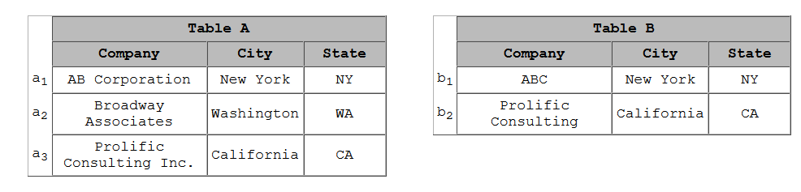
Example
a1=b1
a3=b2
Inexact Inference
In practice, millions of records

Slide 22
Approach
Blocking Followed by Matching
Blocking
<a1,b1>
<a3,b2>

Slide 23
Overview of the algorithm
Express the blocking/matching rules as a random forest
Use Active Learning to build the random forest
Efficient application of rules through indexing

Slide 24
Random Forest
Consists of a set of set of rules
Each rule for selects records that use similarity functions
Edit distance
Overlap similarity
Cosine similarity

Slide 25
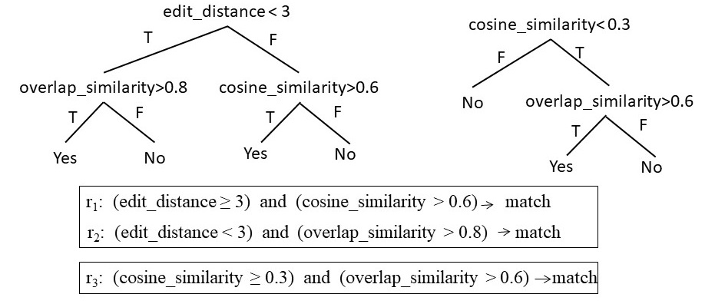
Random Forest

Slide 26
Random Forest
General principles for selecting similarity functions
Numeric-valued attributes such as age, weight, price, etc.
exact match, absolute difference, relative difference, and Levenstein distance
String-valued attributes
edit distance, cosine similarity, Jaccard similarity, and TF/IDF functions.

Slide 27
Active Learning
Randomly select pairs from the two data sets
Ask the users to label them
Use similarity functions to obtain features
Learn random forest
Apply the learned rules to new selected pairs
Evaluate the rules
Iterate

Slide 28
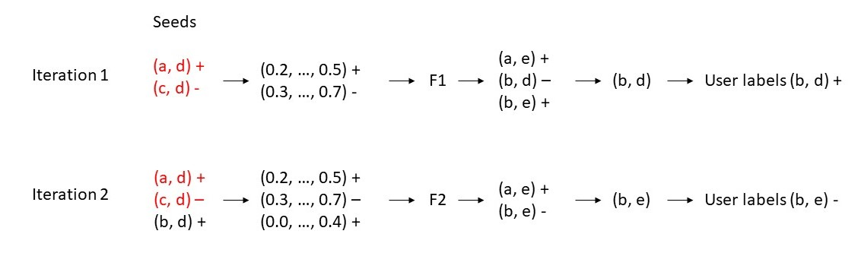
Active Learning
Source 1: (a,b,c) Source 2: (d,e)

Slide 29
Active Learning
Once the learning algorithm converges, present the rules to the user
Retain the rules validated by the user

Slide 30
Rule Application
Leverage indexing for efficient application of rules
Suppose we need to check Jaccard similarity to movie “Sound of Music”
If the similarity needs to be greater than 0.7, we need to consider only those movies with length between 3*0.7, and 3/0.7, ie, between 2 and 4
An index on the length of movies can help us select which movie records to consider

Slide 31
Blocking vs Matching
Same algorithmic outline is used except
The matching rules are more exact/price
The matching is usually verified through human intervention

Slide 32
Summary
Creating KG from structured sources is a data integration problem
Target schema is a knowledge graph
Schema Mapping Problem
Even though bootstrapping is possible, but it is still labor intensive
Record Linkage Problem
Efficiency is a key consideration
Two-step approach with blocking and matching
Leverage random forests and active learning

